Slide 1
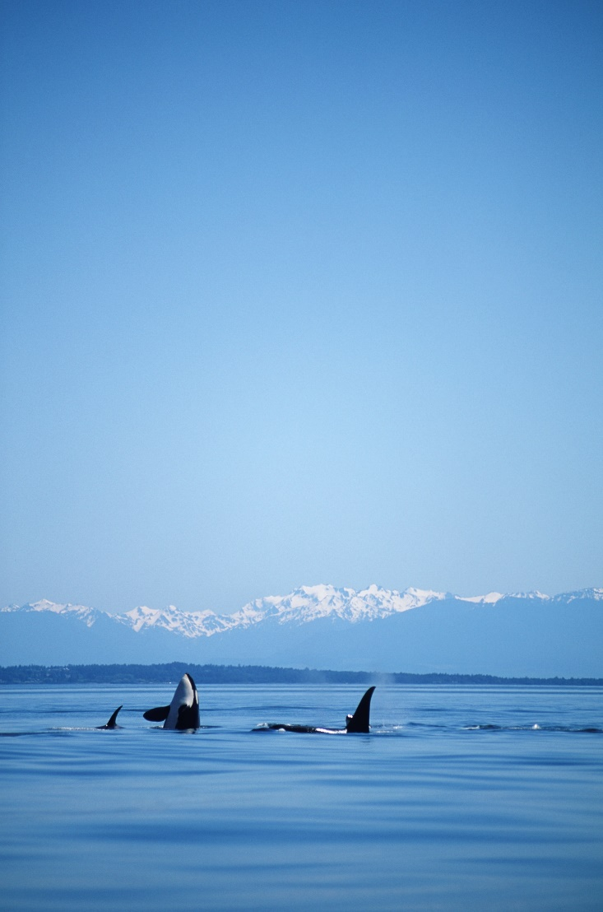
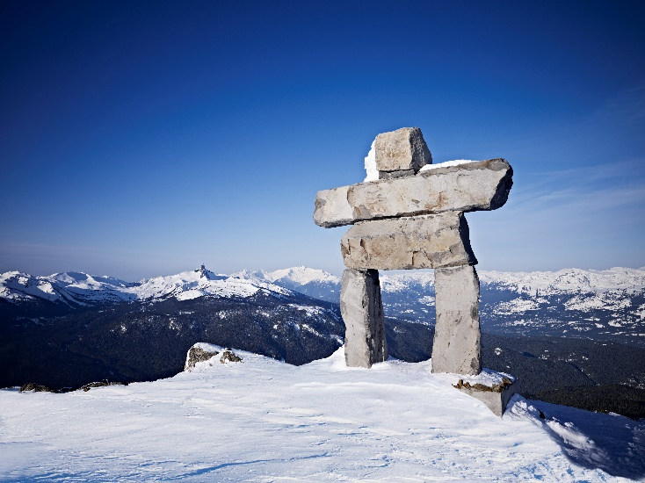
Annual Report 2019

Slide 2
Building a Community Legacy From Deep Cove to Lions Bay

Slide 3
President’s Report
The North Shore Community Foundation is a registered charity based in North Vancouver and our geographical reach extends from Deep Cove to Lions Bay. We have been part of the North Shore for over 30 years and our core mission is to encourage and facilitate local philanthropy and “to accumulate and responsibly administer permanent capital that generates income to fund social, cultural, recreational and educational initiatives that directly benefit the residents of the North Shore”. Said another way, we wish to create a stronger and healthier community not just today but for generations to come.
And perhaps no better example of this is the 2019 recipient of the Foundation’s Annual Golf Tournament donation, the North Shore Disability Resource Centre. The $50,000 donation will be used to create Canada’s first mobile multi-sensory environment, a Mobile Snoezelen Room. This will enable the North Shore Disability Resource Centre to deliver multi sensory experiences and therapies to individuals who may not be able to make it to a multi-sensory room at a fixed location.
As a board, we continue to follow and deliver on our strategic plan and our working committees thrive. To all board members, thank you for your time, expertise, dedication, time away from family and last but equally important, your passion to make the North Shore a better place to work, live and play. Special thanks to a number of departing board members namely Kay Vinall and Aaron Kuzik, each of whom served nine years. What an amazing contribution, huge thanks! Also big thanks to Chris Ball and Jamey Trewartha for their years of service to the Foundation. And I would be remiss if I did not thank Ira Mistry, the Foundation’s Administrator for the countless hours she provides.
The North Shore is a healthy, vibrant, engaged and connected community. It is inclusive, diverse, welcoming and pretty darn beautiful. I know we are all proud to call the North Shore home and excited to make it an even better place to live, work and play. In closing, a quote from an anonymous author….
“You don’t have to be famous or rich to do a good deed. No matter how small it may seem, each kind deed sends a rippling action of kindness to humanity”.
Respectfully submitted,
Michael Boehm
President

Slide 4
Treasurer’s Report
Contributions and revenues
The Foundation’s revenues increased approximately $51,000 in comparison to the previous year. Current donations decreased to $14,289 (2018 - $ 29,221). The primary contributors to the increase in revenues are capital gains realized on the sale of certain of the Foundation’s investments of $117,700 (2018 - $23,350) as our investment managers rebalance and seek long term value investment positions. Management fee income also increased to $32,500. These are fees earned from the management and administration of the Mayors’ Golf Tournament. Fundraising and investment income continue to be the primary sources on revenue.
The Mayors’ Golf Tournament raised around $186,000 in net profit and distributed a total $180,000. The current distributions were allocated $50,000 to the designated charity – North Shore Disability Resource Centre, $97,500 was added to the Foundation’s Mayors’ Community Trust Fund and $32,500 was added to the Foundation’s operating budget.

Slide 5
Treasurer’s Report (cont’d)
Disbursements and Expenditures
Total grants and disbursements for the year are just over $166,000 (2018 - $208,000). The primary reason for the decrease in grants was due to lower moving average investment returns. During the year, the Board approved a 4% rate of return to be disbursed on endowment funds. This was down slightly from the 5% disbursed in 2018. Fundraising expenditures, net of the disbursements to the Mayors’ Community Trust Fund, decreased by $15,000 compared to 2018. The Board is committed to keeping costs as low as possible while striving to achieve greater awareness of the Foundation. We have internally calculated our administration costs at 0.70% for 2019 and 0.88% for 2018 of total asset value.
Operating Surplus
The current year’s operations ended with a surplus of $88,661 (2018 deficit - $17,187). The primary reason for the surplus is our use of a five-year rolling average rate of return to determine the amount of funds to disburse. In 2019, the total return for the granting cycle was 5.76%, however lower total returns in prior years resulted in a lower five-year average for disbursement purposes. The Foundation has recorded an unrealized gain on investments of $29,652 (2018 – gain of $14,829) which represents the write up of investments to market value as at 30 June 2019.
Net income prior to unrealized gains is $59,009 (2018 – net loss of $32,016). This balance includes the Foundation’s share of the net proceeds from the 2019 Mayors’ Golf Tournament of $97,500 (2018 - $110,000) which have been internally restricted by the Board and are not available for current operating expenditures.
Investment Portfolio
Current accounting standards require reporting investments which are quoted in an active market at fair value. The Foundation’s book value of these investments, which consists of investments held at RBC Dominion Securities and The Vancouver Foundation, is $3,024,807 (2018 - $2,868,246). As disclosed on the statement of financial position, the fair value of these investments is $3,633,370 (2018 - $3,435,868). The book value increase is largely due to endowment contributions received during the year plus accrued capital gains realized on certain investments. The current asset allocation is within the Foundation’s investment policy and consists of 34% fixed income, 31% Canadian Equity and 35% Foreign Equity.
Aaron Kuzik, CPA, CA Treasurer

Slide 6
Grants and Distributions
During the fiscal year ending June 30, 2019, the Board of Directors of the North Shore Community Foundation approved grants and distributions totaling approximately $191,000.
Item | Amount
Available for community granting, which is subject to an application process, is $76,373 for the fiscal year ending June 30, 2019. The approved recipients of the funds available will be determined, and funds disbursed, in November 2019. | $76,373
Directed Funds:
Directed Endowment Funds
District of North Vancouver Community Heritage Grants Fund | $2,479
Evergreen House Music Fund | $1,135
Fund for the Arts of the North Shore (FANS) | $5,359
North Shore Neighbourhood House | $3,015
North Vancouver Community Arts Centre | $647
North Vancouver District Public Library | $658
North Vancouver Museum & Archives | $2,266
St. Martin’s Church Fund | $482
Scholarship Funds
City of North Vancouver Youth Centennial Scholarship Fund | $5,000
Colin Jones Memorial Fund | $3,000
Judy Dennis Scholarship Fund | $2,000
North Vancouver Minor Hockey Association | $6,500
Rotary Club of North Vancouver Scholarship Fund | $4,000
Strongman All-Rounder Awards | $28,000
 | $64,541
North Shore Mayors’ Annual Golf Tournament:
Designated Charity: North Shore Disability Resource Centre | $50,000
Total Grants and Disbursements | $190,914

Slide 7
Grants and Distributions (cont’d)
The community grants presented in November 2018 for the 2017-2018 fiscal year were:
Agency | Project | Amount
Hollyburn Family Services |  | $5,500
MADD Metro Vancouver |  | $3,498
Big Sisters of B.C. Lower Mainland |  | $6,000
Children of the Street Society |  | $6,000
North Shore Keep Well Society |  | $3,000
Avalon Recovery Society |  | $5,500
Athletics 4 Kids Society |  | $5,000
Crisis Intervention and Suicide Prevention Society |  | $2,500
Polygon Gallery |  | $5,000
Zajac Ranch Society |  | $3,000
North Shore Meals on Wheels Society |  | $6,000
North Shore Stroke Recovery Society |  | $2,500
Seymour Art Gallery |  | $2,000
Vancouver Orphan Kitten Rescue |  | $10,000

Slide 8
How To Give
Gifts to the North Shore Community Foundation can be made during your lifetime or after your death. You may make a gift to:
An existing open fund to be chosen by the Board of Directors.
A specific existing open fund (see our website for more details).
Establish a new open or closed fund for the charitable purposes specified by you. To start a new fund, a minimum donation of $10,000 is required, received as a lump sum or in installments over a period of time. The fund can be tailored to your specific interests and wishes.
You are encouraged to discuss your proposed gift with a lawyer and/or a tax advisor to ensure you understand all aspects of your donation. It is not our intention to provide legal or tax advice.
What to Give
Cash: Gifts of cash, whether by cheque, money order or credit card, are the most common ways to donate to a charity and can be of any amount. A donation mailed in December, even if not received until January, qualifies as a charitable donation for the year in which it was mailed.
Securities: A gift of publicly traded securities, such as stocks, bonds or mutual funds, can save you a considerable amount in capital gains tax. If your securities have increased in value since you purchased them, 50 per cent of the gain is taxable. Since 2006, however, you will not have to pay any capital gains tax on the donation of securities to a charity, such as the North Shore Community Foundation.
Other Property: Gifts of real estate and/or personal property may be accepted by the Foundation for management or sale. A fair market valuation for such gifts must be established to the satisfaction of Canada Revenue Agency. The ready marketability of the property and the carrying costs are among the factors in determining the acceptance of this type of gift by the Foundation.
Life Insurance: Life insurance policies can be a tax-effective way to give to our Foundation. There are a number of different types of policies and ways to structure the giving of life insurance. You may give an existing policy which is no longer needed for its intended purpose, or establish a new life insurance policy as a planned gift. It is important to discuss the alternatives for this type of donation with an estate planner or other professional advisor. We would also be pleased to discuss these options with you and your advisor.

Slide 9
How To Give (cont’d)
RRSPs and RRIFs: If your spouse is alive, there is a tax advantage to naming him or her as the beneficiary of your RRSP or RRIF. However, if you do not have a spouse or your spouse has passed away, your estate will be taxed on any remaining RRSP or RRIF funds, once you have passed away. If you choose to name the Foundation as the beneficiary of your RRSP or RRIF, your estate will receive a charitable donation receipt to offset the tax.
Will: You may not be able to afford to make a gift to a charity during your lifetime, but you may have assets that will pass to your estate under a Will. A bequest to the Foundation through your Will is a common option for a charitable donation. It may be for a specific amount or a percentage of the residue of your estate. You should consult with your lawyer about preparing a new Will or a codicil to your existing Will, and to help you word your wishes for this bequest.
Sample Clause:
To give $ (or X% of the residue of my estate) to the North Shore Community Foundation, PO Box 37104 Lonsdale, North Vancouver, BC V7N 4M0.
(options)
to add to an open endowment fund to be selected by the Board of Directors of the Foundation
to add to the ____________________ endowment fund
to establish a new endowment fund to be known as ____________________ for the purpose of ____________________
Charitable Remainder Trusts: A Charitable Remainder Trust is an arrangement in which you irrevocably transfer assets (for example: cash, securities, property) to a trustee during your lifetime. You retain the right to the income from the trust either for your lifetime or for a specified number of years. After that time, the assets are transferred to the Foundation. See your lawyer to discuss this option.

Slide 10
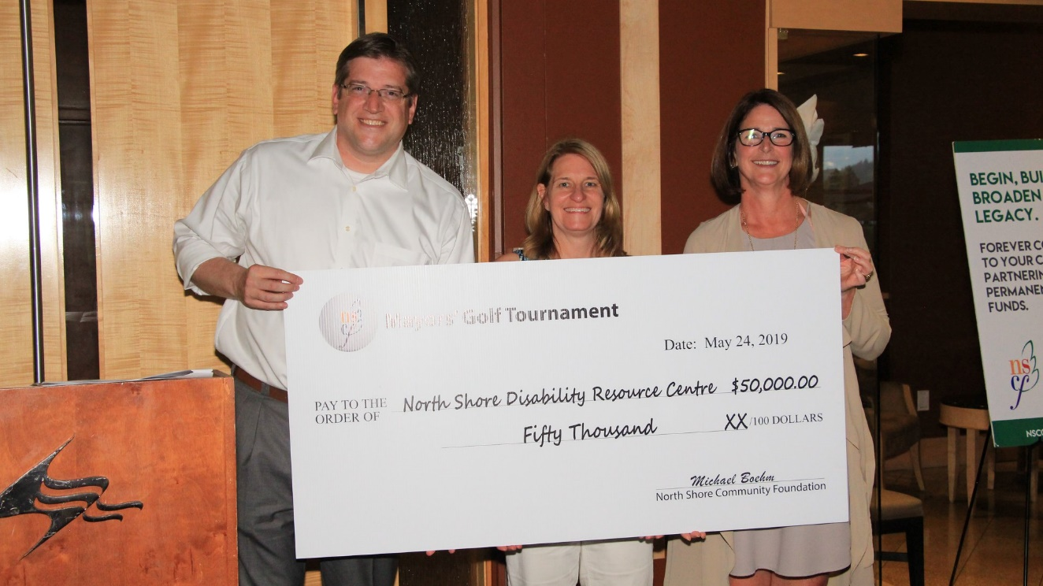
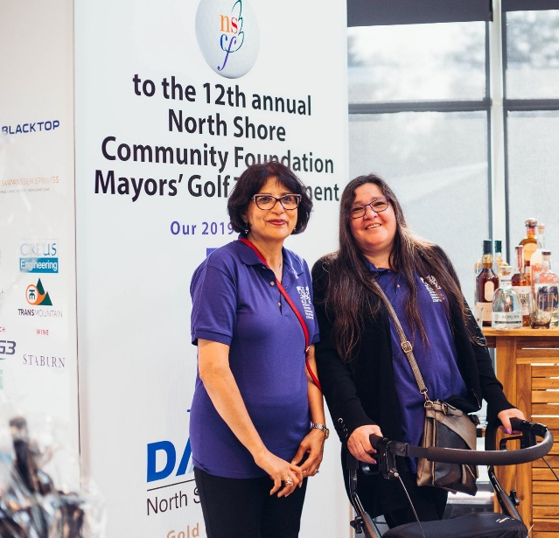
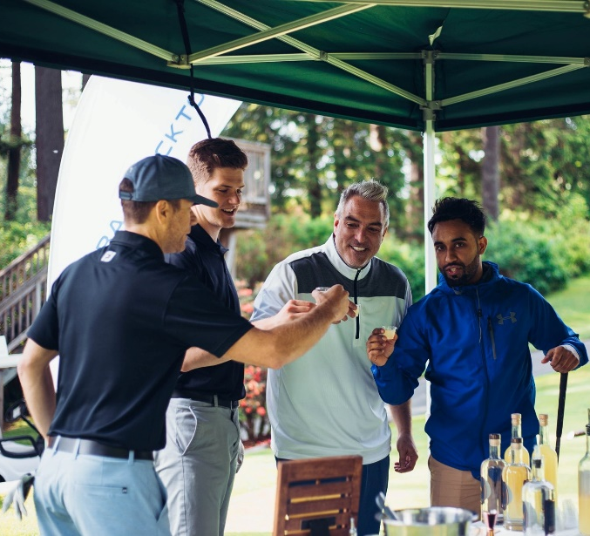
North Shore Mayors’ Golf Tournament
North Shore Disability Resource Centre was the beneficiary of the $50,000 raised at the 12th annual North Shore Mayors’ Golf Tournament. The proceeds will be used to create Canada’s first mobile multi-sensory environment, a Mobile Snoezelen Room. This will enable the North Shore Disability Resource Centre to deliver experiences and therapies to a wider variety of individuals at convenient times and locations.
(Below: guests arrive for the tournament)
Below: guests arrive and golf begins.

Slide 11
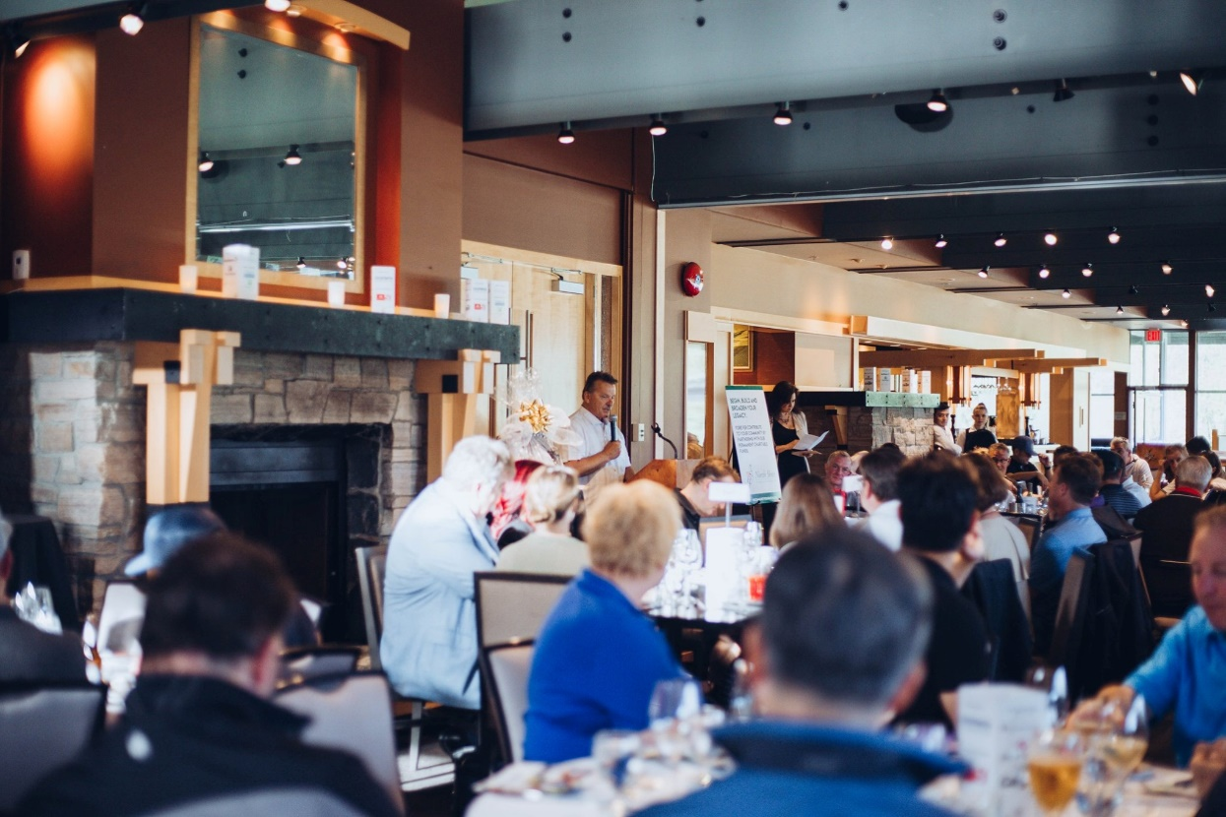
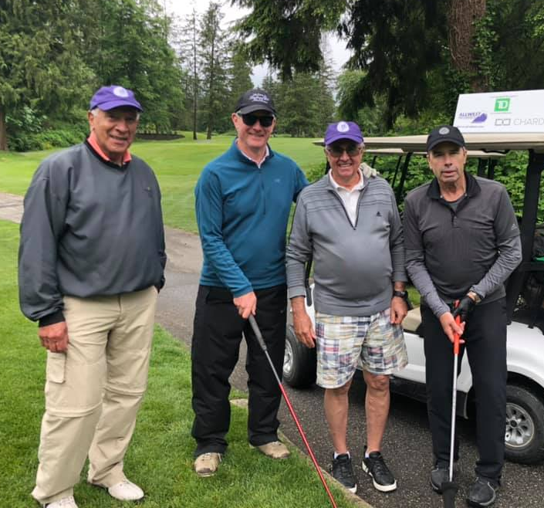
North Shore Mayors’ Golf Tournament (cont’d)
(Above: Foundation President Mike Boehm kicks
off the festivities. Left: golfers in paradise. Below:
former Foundation President Dave Alsop
and his foursome)

Slide 12
Review Engagement Reports and Financial Statements June 30, 2019

Slide 13
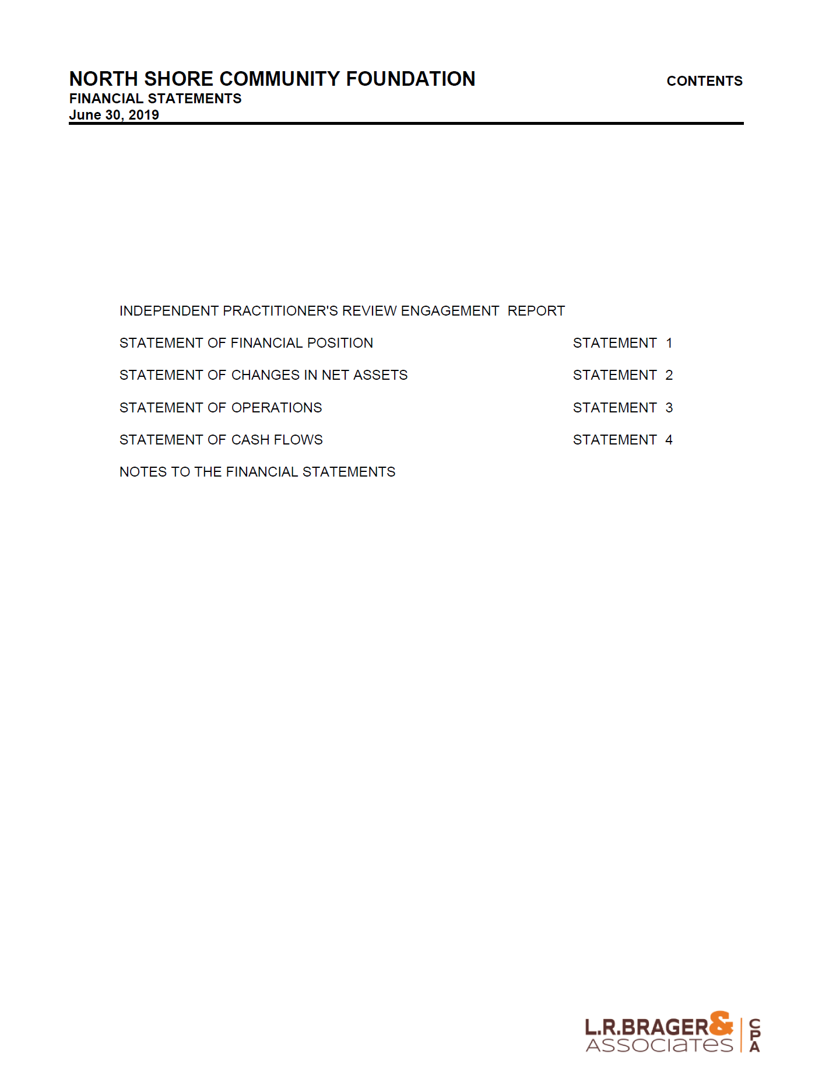

Slide 14
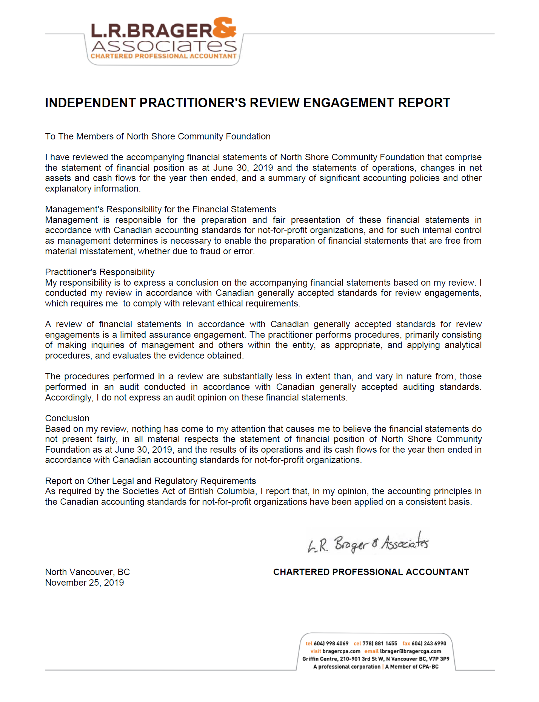

Slide 15
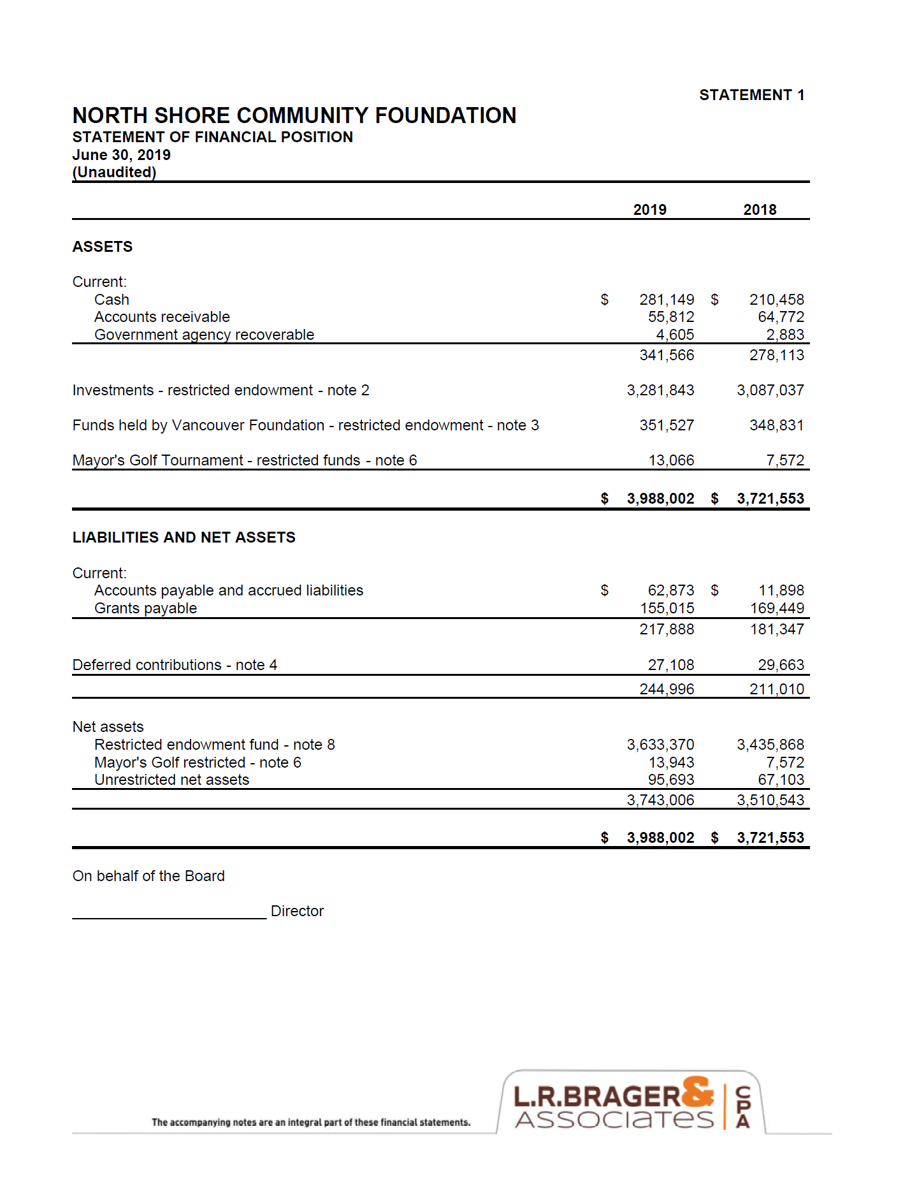

Slide 16
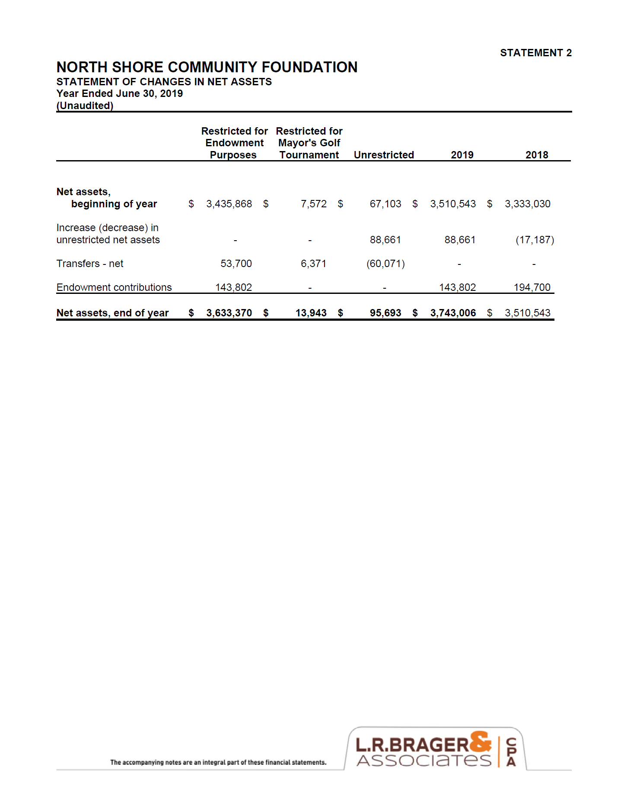

Slide 17
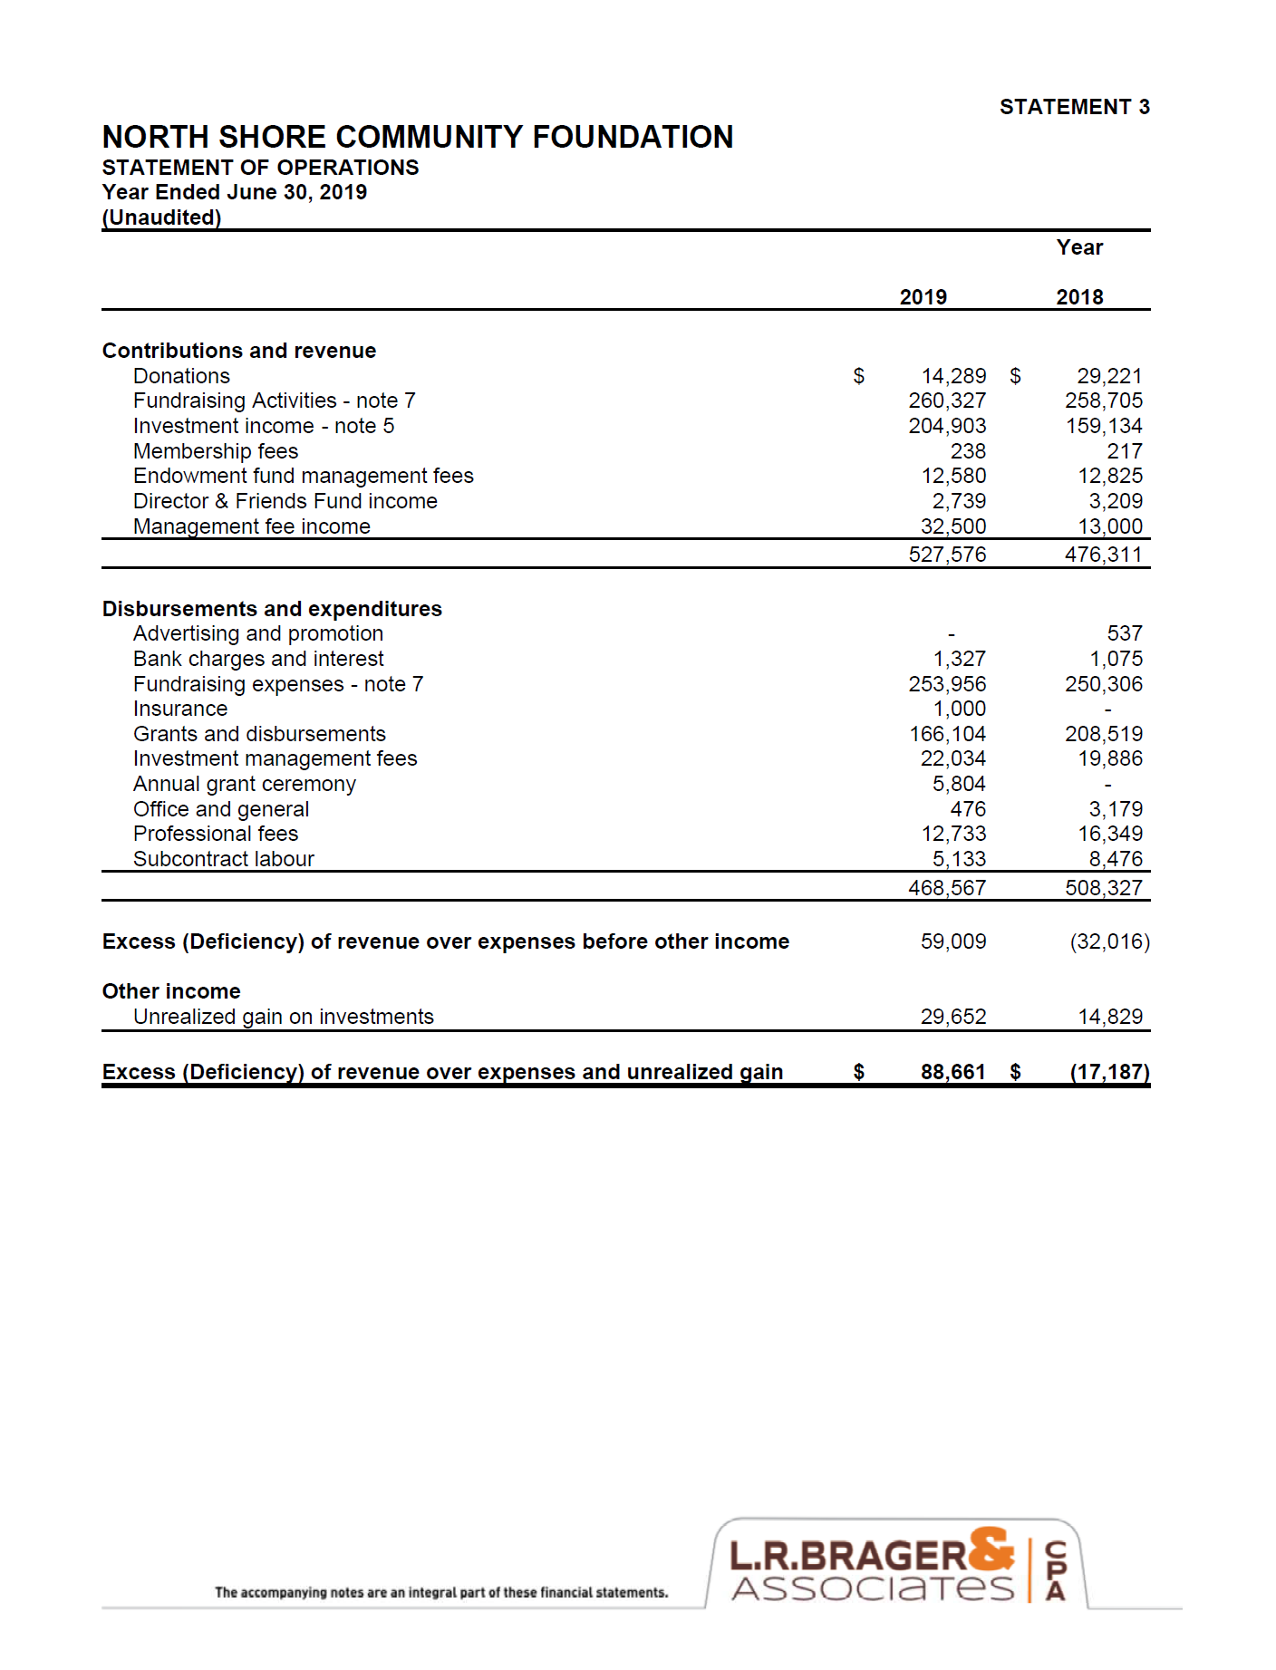

Slide 18
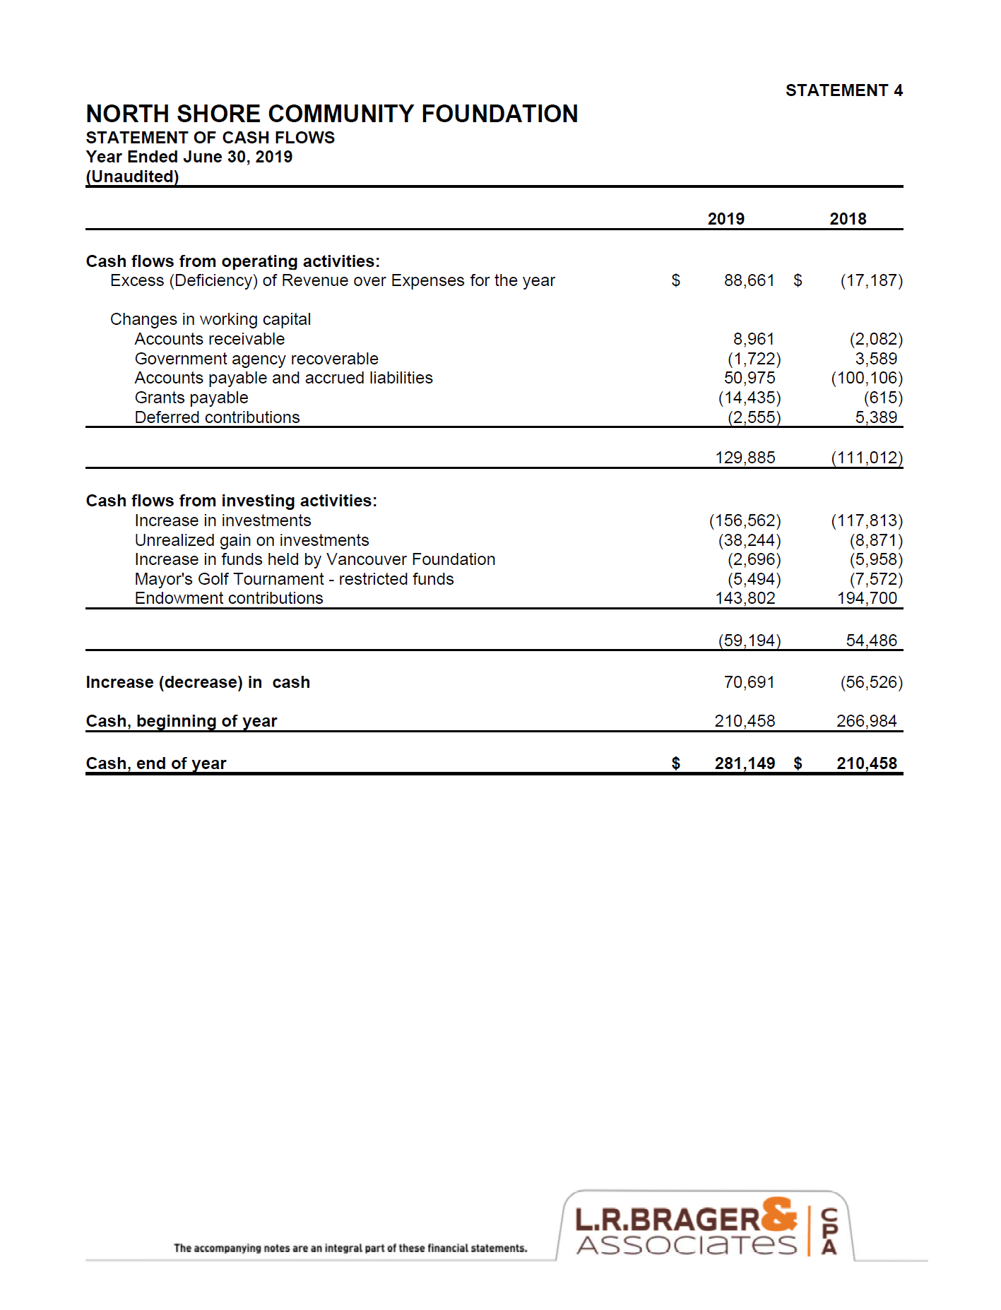

Slide 19
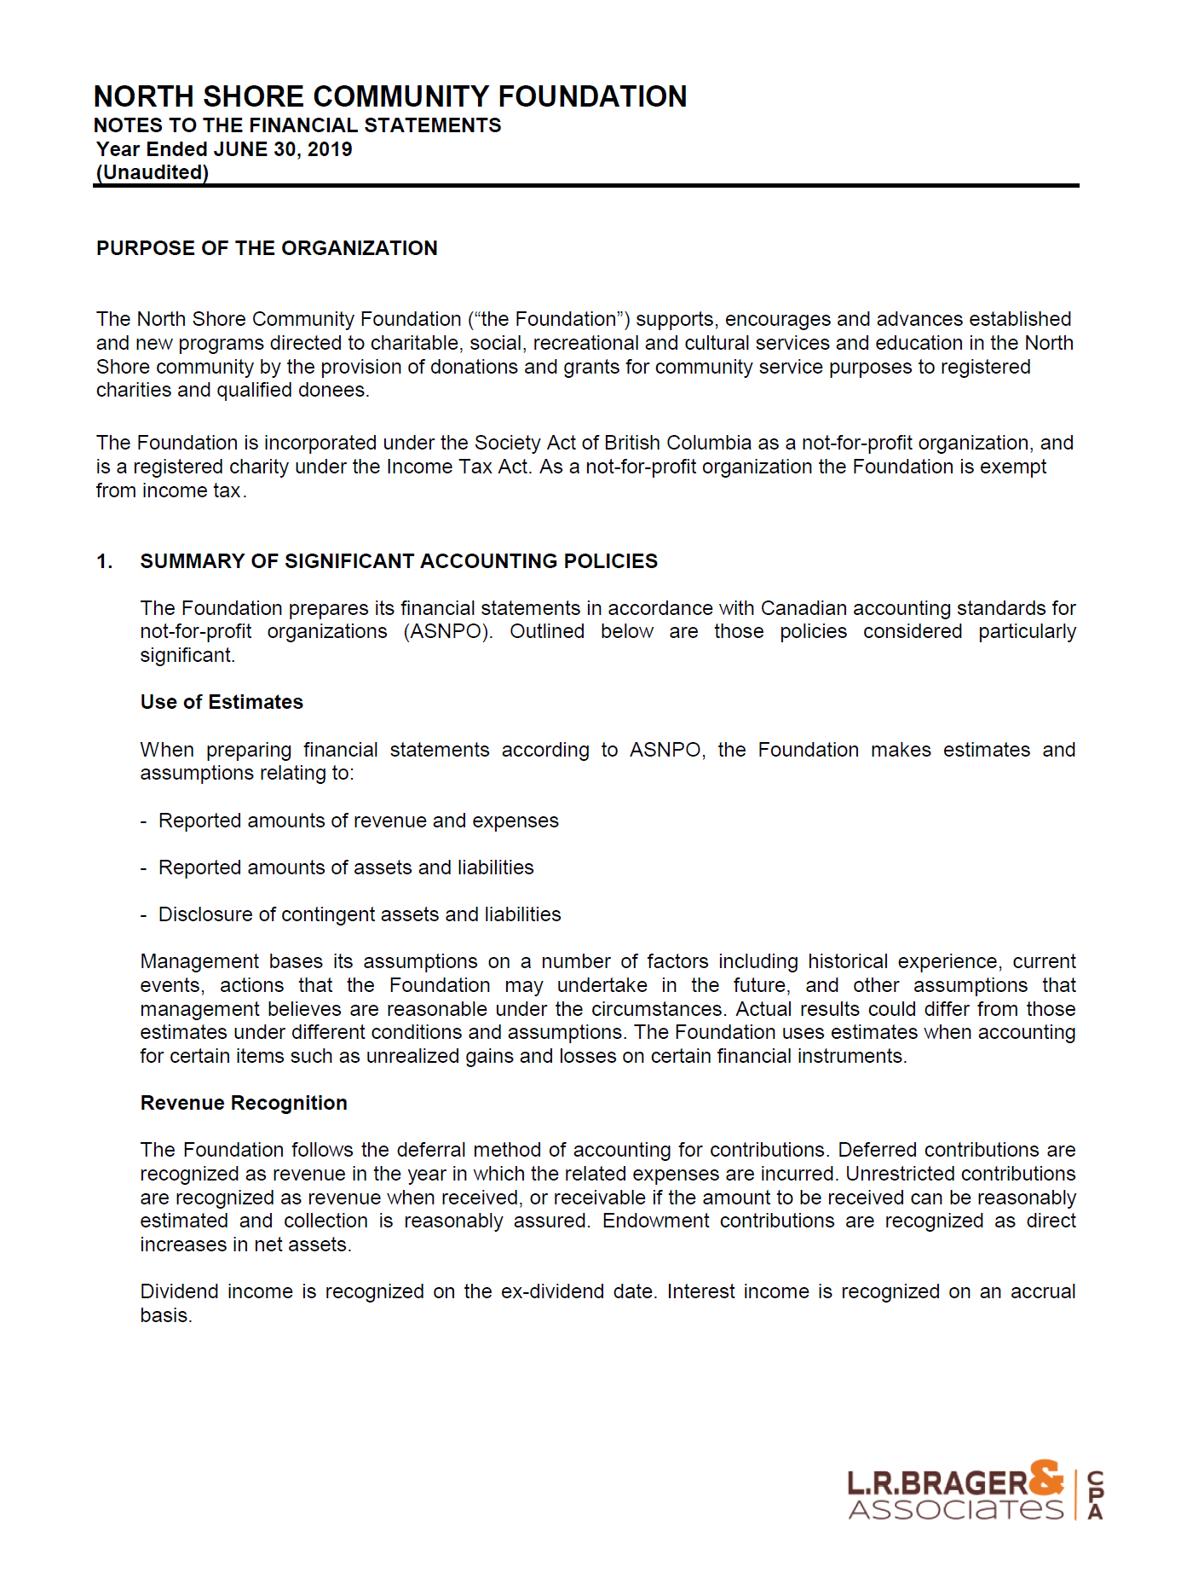

Slide 22
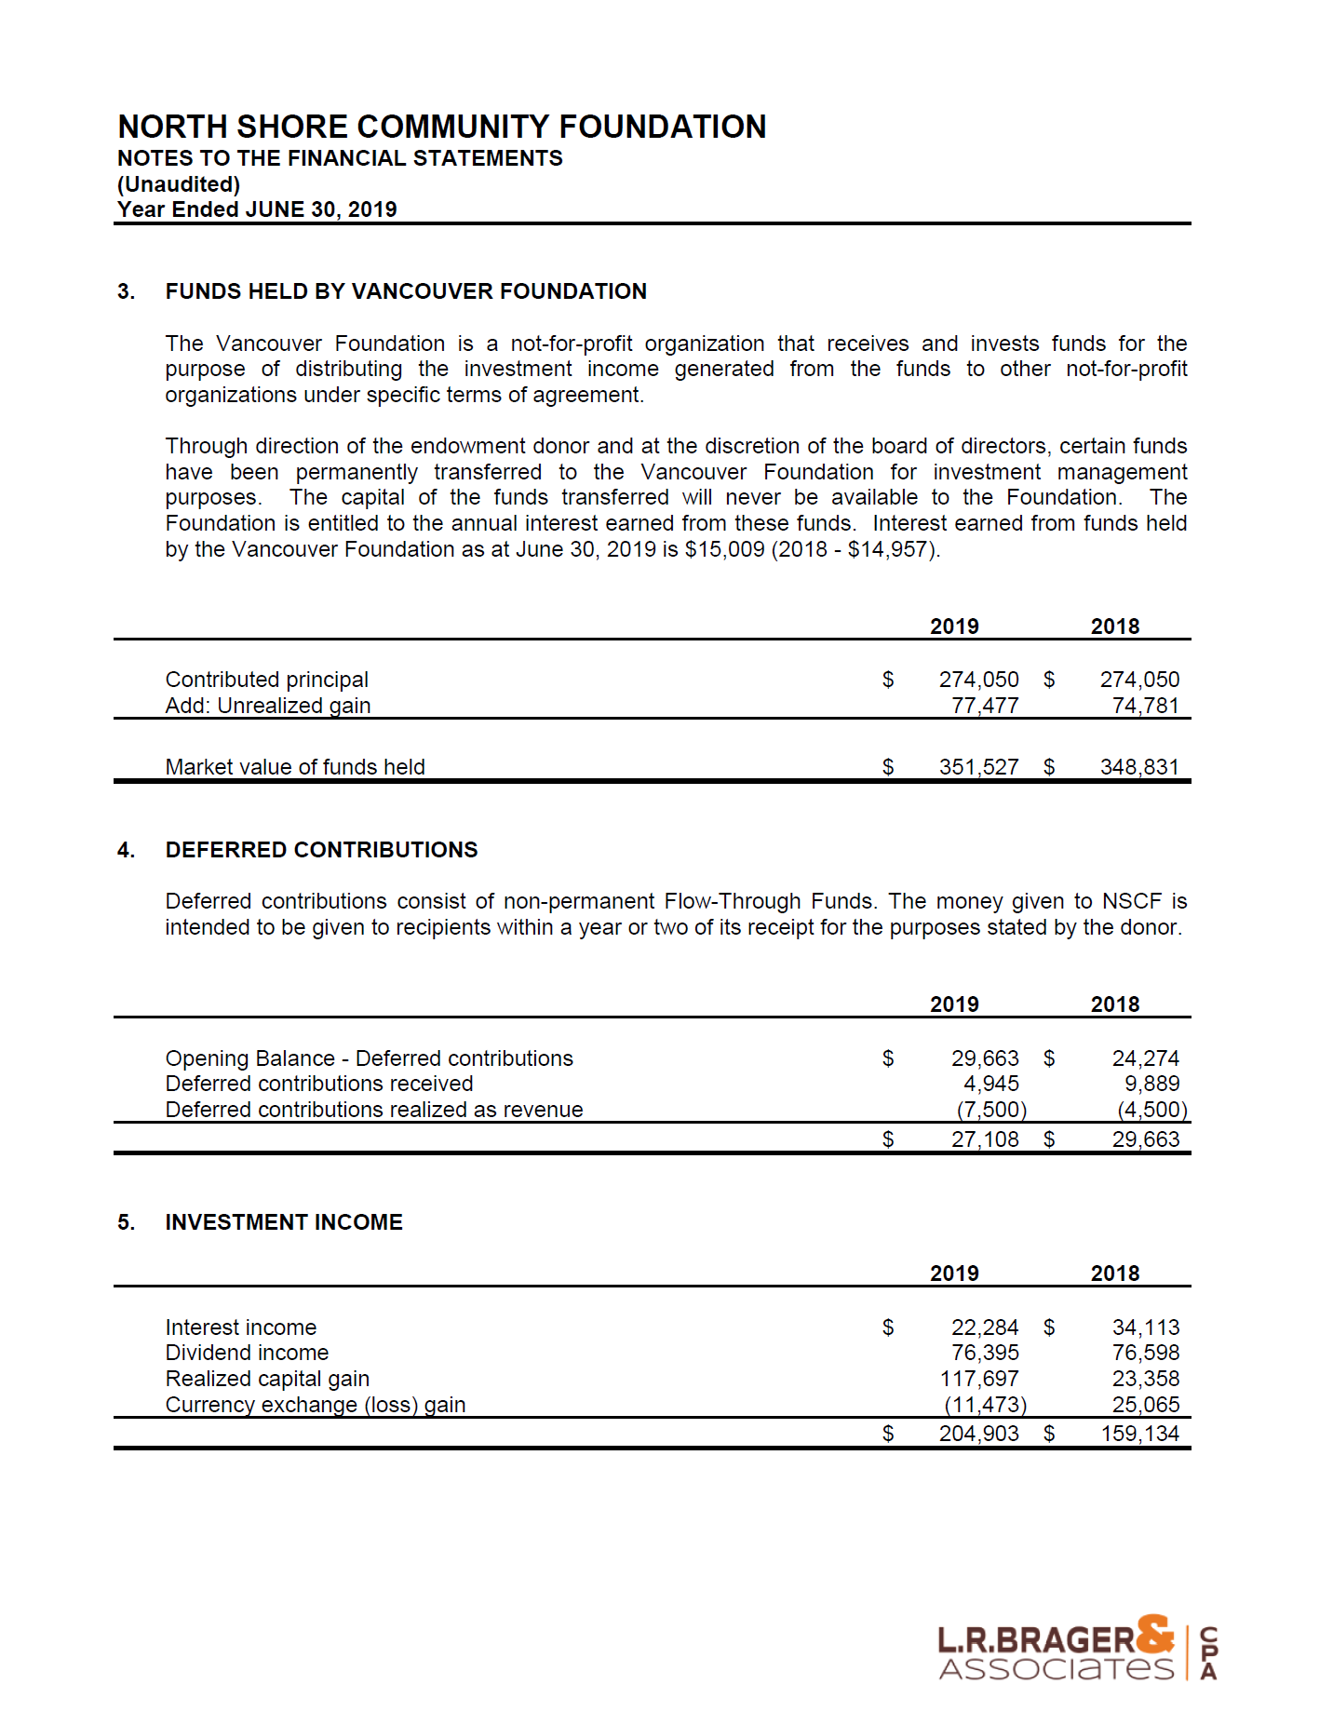

Slide 23
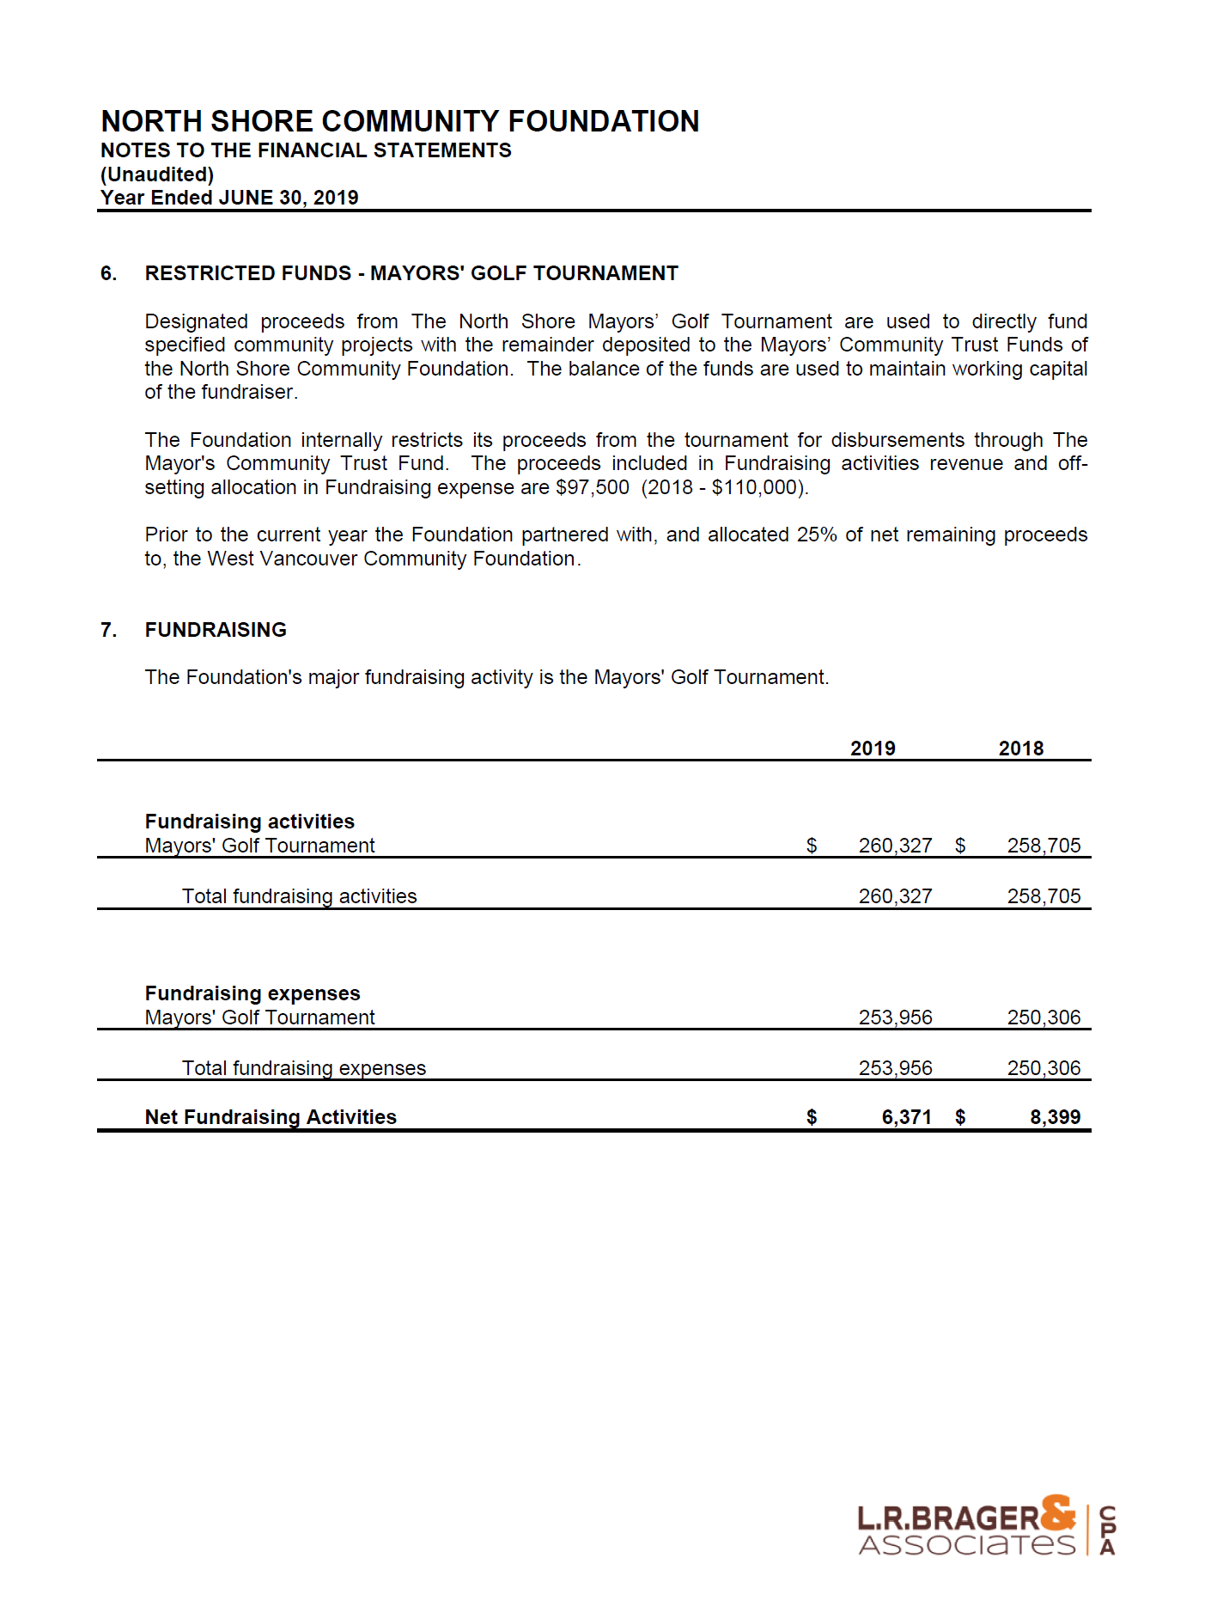

Slide 24
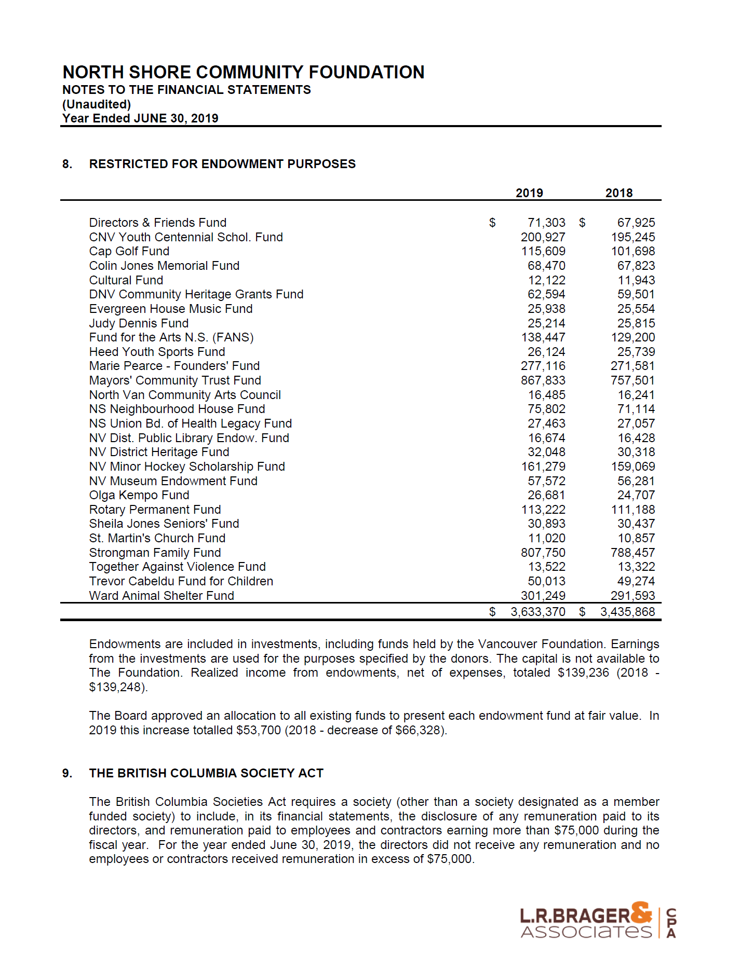

Slide 25
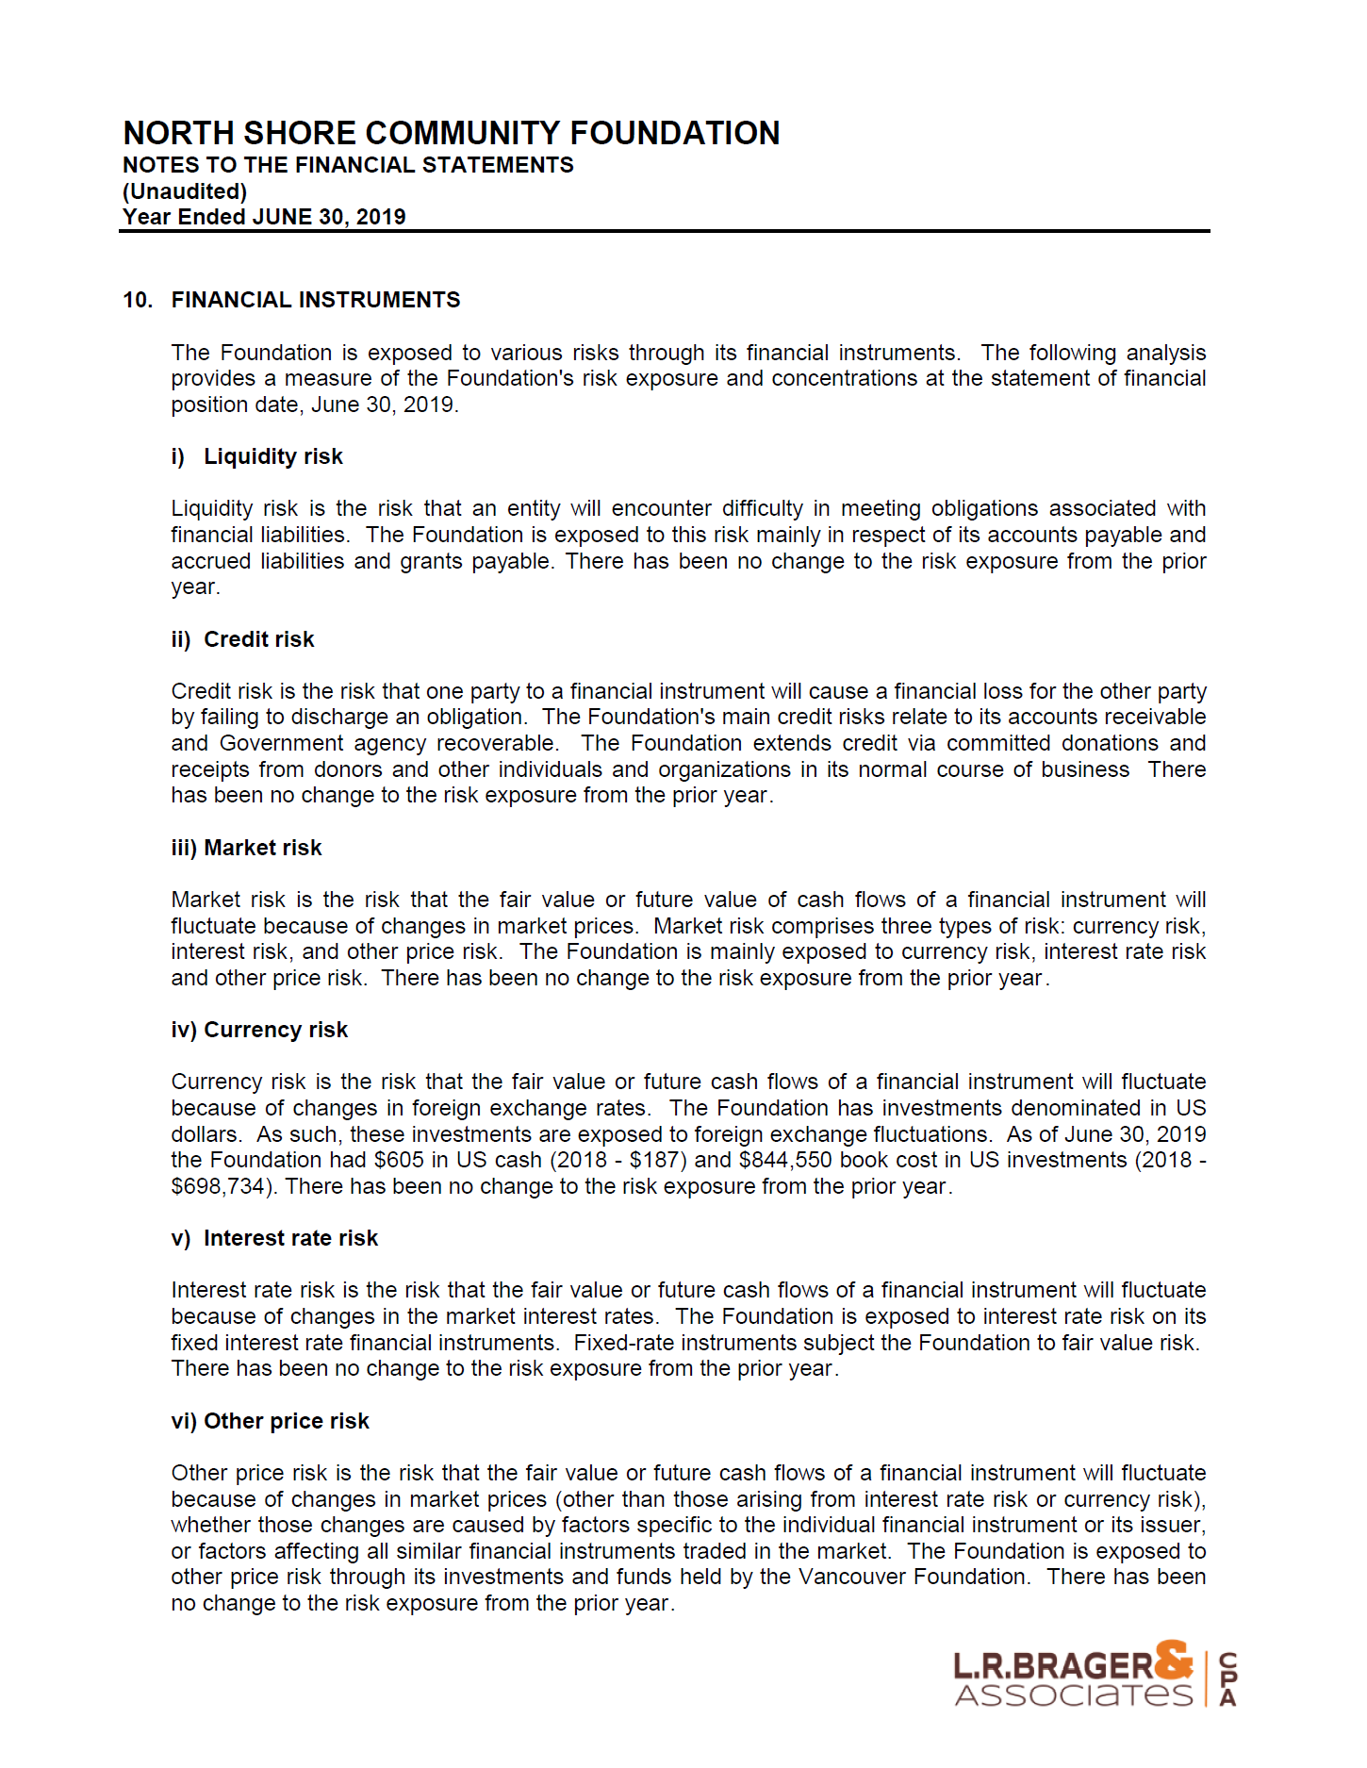

Slide 26
2018-2019 Board of Directors
North Shore Community Foundation
PO Box 37104 Lonsdale
North Vancouver, BC V7N 4M0 T: 604.998.4460
E: info@nscommunityfoundation.com W: www.nscommunityfoundation.com
North Shore Community Foundation 2019 Annual Report CRA No. 891642043 RR0001
Name | Title
Michael Boehm | President
Tim McMorran | Vice President
Aaron Kuzik | Treasurer
Kay Vinall | Corporate Secretary
Chris Ball | Director
Najeeb Hassan | Director
Stephanie Orr | Director
David Phillips | Director
Brett Terrillon | Director
Jamey Trewartha | Director (resigned during the year)
Jordan Willms | Director
Shannon DeSouza | Director (appointed during the year)

